Slide 1

Road Sign Recognition Using CNN
Presented by,
Arjun M
DA & DS
March batch

Slide 2


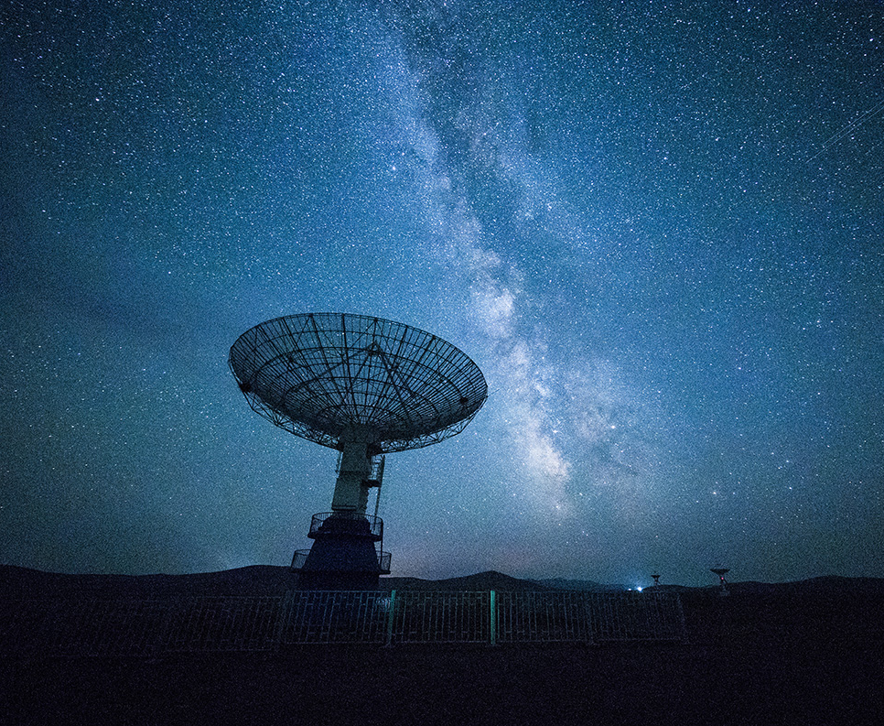
Project Overview
Objective: Build a Convolutional Neural Network to classify road signs from images.
Approach: Data preprocessing → CNN model → Evaluation → Streamlit UI>

Slide 3
Objectives

Slide 4
Project Workflow
Data Collection → Data Preprocessing → CNN Model → Training → Evaluation → Streamlit UI

Slide 5
Data Collection
Downloaded road sign dataset
Loaded images and labels into Python environment
Data Preprocessing
Resized images to consistent shape (e.g., 64x64x3)
• Normalized pixel values

Slide 6
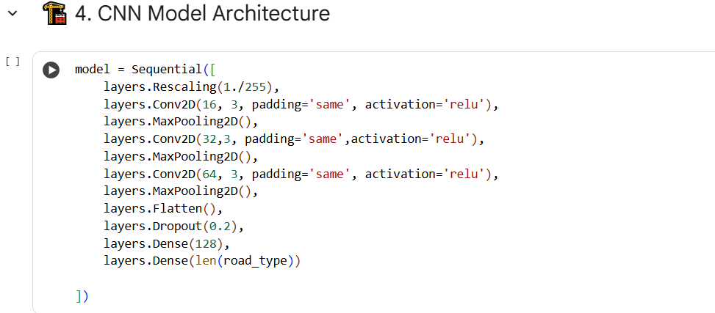
CNN Architecture
Input Layer → Conv Layers → Pooling → Flatten → Dense → Output
Activation: ReLU for hidden layers, Softmax for output layer

Slide 7
CNN Layers
• Convolutional Layers extract spatial features
• Max-Pooling reduces dimensionality
• Fully Connected Layers classify images

Slide 8
Data Splitting
Training: 70%
Validation: 15%
Testing: 15%

Slide 9
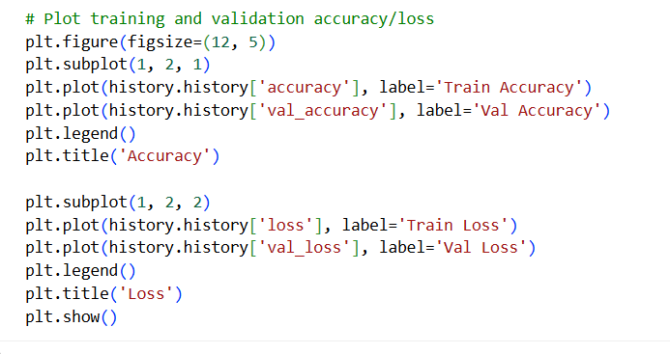
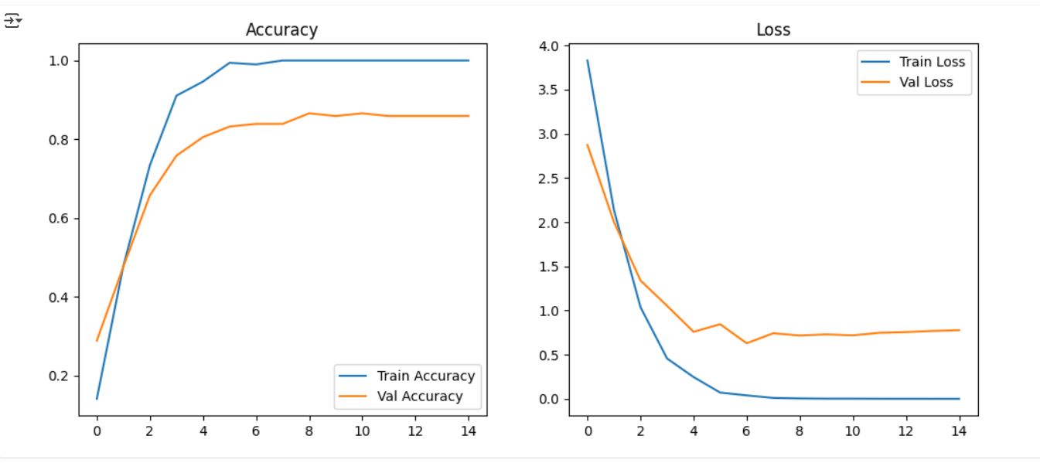
TRAINING

Slide 10
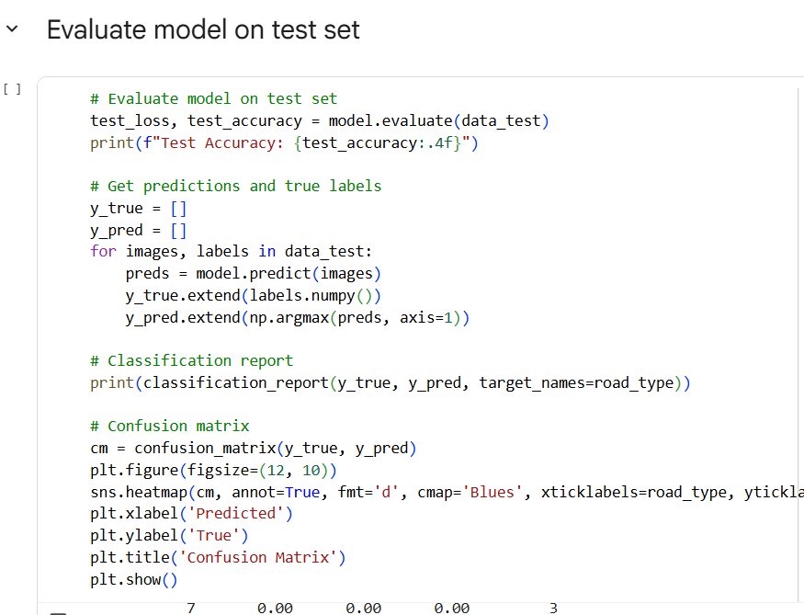
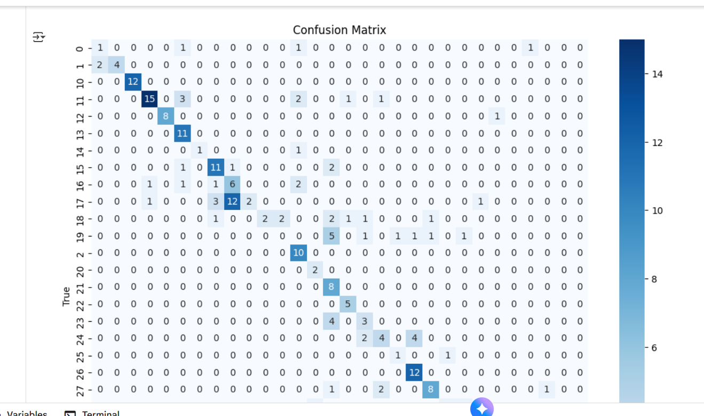
TESTING

Slide 11
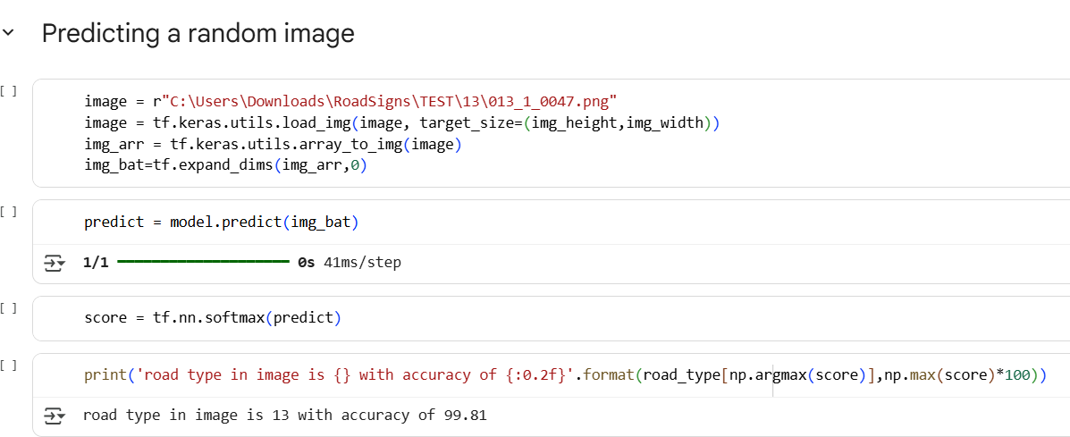
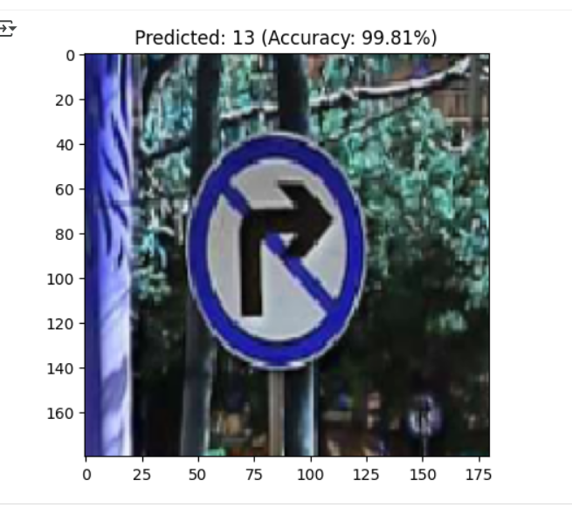
PREDICTION

Slide 12
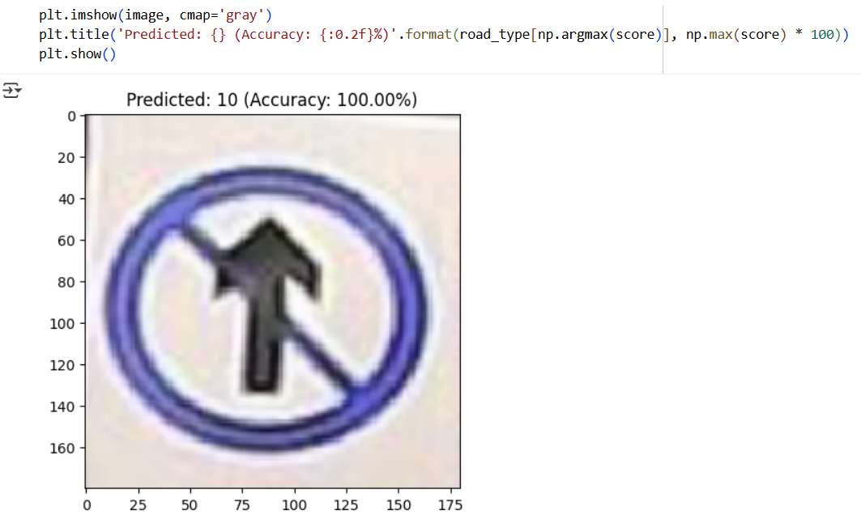
Model Training
Trained CNN on training data
Used early stopping and checkpoints
Monitored validation accuracy

Slide 13
Model Evaluation
Metrics: Accuracy, Precision, Recall, F1-Score
Tools: Confusion Matrix, Classification Report

Slide 14
: Hyperparameter Tuning
• Used Grid Search / Random Search
• Tuned learning rate, kernel size, number of filters, dropout rate

Slide 15
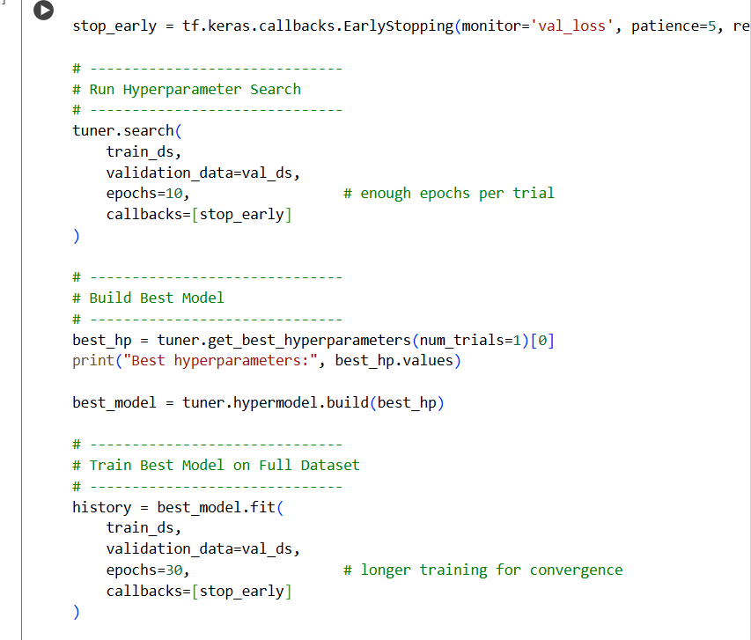
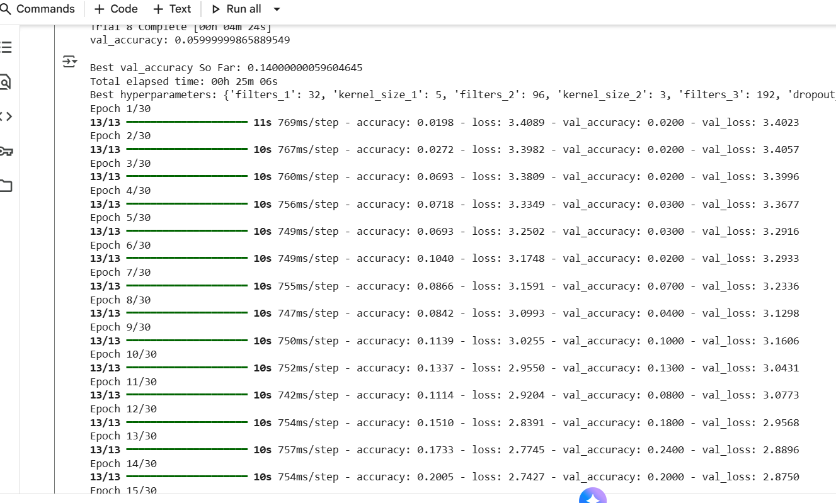

Slide 16
Model Optimization
Tried different CNN architectures
• Added dropout layers
• Balanced performance and complexity

Slide 17
Streamlit UI
• Built interactive UI to upload test images
• Displayed accuracy and predicted class
• Easy for end-users to test the model

Slide 18
Conclusion
Results: High model accuracy and successful road sign recognition

Slide 19

Thank You!

